Slide 1

The Many-to-Many Relationship
Fearful concatenation of circumstances
Daniel Webster

Slide 2
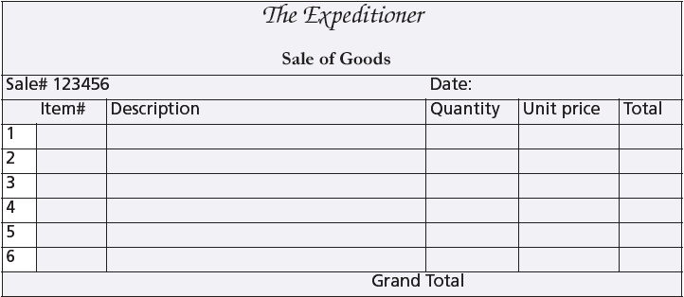
A sales form

Slide 3
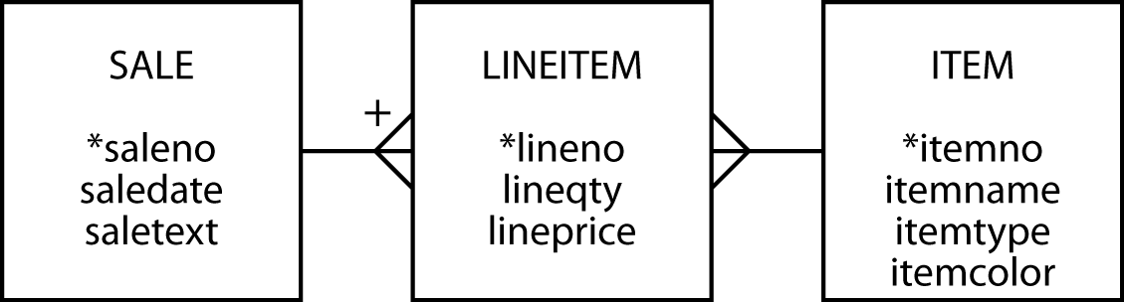
The many-to-many relationship
Create a third entity to map an m:m relationship
  An associative entity
The vertical bar on the crow's foot indicates that LINEITEM is identified by concatenating saleno and lineno

Slide 4
The many-to-many relationship
Create a third entity to map an m:m relationship
  An associative entity
The vertical bar on the crow's foot indicates that LINEITEM is identified by concatenating saleno and lineno

Slide 5
Why a third entity?
Store data about the relationship
Think of an m:m as two 1:m relationships

Slide 6
Creating a relational database
Same rules apply
The associative table has two foreign keys
  One for each of the entities in the m:m relationship
A foreign key can also be part of the primary key of an associative entity
lineitem
lineno | lineqty | lineprice | saleno | itemno
1 | 1 | 4.50 | 1 | 2
1 | 1 | 25.00 | 2 | 6
2 | 1 | 20.00 | 2 | 16
3 | 1 | 25.00 | 2 | 19

Slide 7
Creating a relational database
CREATE TABLE sale (
saleno INTEGER,
saledate DATE,
saletext VARCHAR(50),
PRIMARY KEY(saleno));
CREATE TABLE item (
itemno INTEGER,
itemname VARCHAR(30),
itemtype CHAR(1),
itemcolor VARCHAR(10),
PRIMARY KEY(itemno));
CREATE TABLE lineitem (
lineno INTEGER,
lineqty INTEGER,
lineprice DECIMAL(7,2),
saleno INTEGER,
itemno INTEGER,
PRIMARY KEY(lineno,saleno),
CONSTRAINT fk_has_sale FOREIGN KEY(saleno) REFERENCES sale(saleno),
CONSTRAINT fk_has_item FOREIGN KEY(itemno) REFERENCES item(itemno));

Slide 8
A three table join
List the names of the three tables after FROM
Specify two matching conditions with the associative table in both join conditions
  SELECT * FROM sale, lineitem, item
  WHERE sale.saleno = lineitem.saleno
  AND item.itemno = lineitem.itemno;

Slide 9
A three table join
List the names of items, quantity, and value of items sold on January 16, 2003
SELECT itemname, lineqty, lineprice, lineqty*lineprice
AS total FROM sale, lineitem, item
WHERE lineitem.saleno = sale.saleno
AND item.itemno = lineitem.itemno
AND saledate = '2003-01-16';
itemname | lineqty | lineprice | total
Pocket knife—Avon | 1 | 0.00 | 0.00
Safari chair | 50 | 36.00 | 1800.00
Hammock | 50 | 40.50 | 2025.00
Tent—8 person | 8 | 153.00 | 1224.00
Tent—2 person | 1 | 60.00 | 60.00

Slide 10
EXISTS
Existential qualifier
Returns true or false
Returns true if the table contains at least one row satisfying the specified condition
Report all clothing items (type “C”) for which a sale is recorded
SELECT itemname, itemcolor FROM item
WHERE itemtype = 'C'
AND EXISTS (SELECT * FROM lineitem
WHERE lineitem.itemno = item.itemno);
itemname | itemcolor
Hat—Polar Explorer | Red
Boots—snake proof | Black
Pith helmet | White
Stetson | Black

Slide 11
NOT EXISTS
Returns true if the table contains no rows satisfying the specified condition
Report all clothing items (type “C”) that have not been sold
SELECT itemname, itemcolor FROM item
WHERE itemtype = 'C'
AND NOT EXISTS
(SELECT * FROM lineitem
WHERE item.itemno = lineitem.itemno);
itemname | itemcolor
Hat—Polar Explorer | White
Boots—snake proof | Green
Pith helmet | Khaki
Stetson | Brown

Slide 12
Divide
The universal qualifier
  forall
Not directly mapped into SQL
Implement using NOT EXISTS
  Find all items that have appeared in all sales
  becomes
  Find items such that there does not exist a sale in which this item does not appear

Slide 13
Divide
Find the items that have appeared in all sales
SELECT itemno, itemname FROM item
WHERE NOT EXISTS
(SELECT * FROM sale
WHERE NOT EXISTS
(SELECT * FROM lineitem
WHERE lineitem.itemno = item.itemno
AND lineitem.saleno = sale.saleno));
itemno | itemname
2 | Pocket knife—Thames

Slide 14
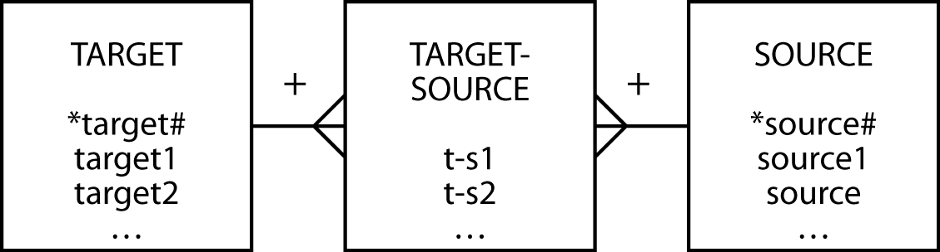
A template for divide
Find the target1 that have appeared in all sources
SELECT target1 FROM target
WHERE NOT EXISTS
(SELECT * FROM source
WHERE NOT EXISTS
(SELECT * FROM target-source
WHERE target-source.target# = target.target#
AND target-source.source# = source.source#));

Slide 15
Beyond the great divide
Find the items that have appeared in all sales
  can be rephrased as
Find all the items for which the number of sales that include this item is equal to the total number of sales.
SELECT item.itemno, item.itemname
FROM item, lineitem
WHERE item.itemno = lineitem.itemno
GROUP BY item. itemno, item.itemname
HAVING COUNT(DISTINCT saleno)
= (SELECT COUNT(DISTINCT saleno) FROM sale);
First determine the number of sales in which an item has appeared
Second compare the number of sales to the total number of sales

Slide 16
Set operations
UNION
  Equivalent to OR
INTERSECT
  Equivalent to AND

Slide 17
UNION
List all items that were sold on January 16, 2003, or are brown.
SELECT itemname FROM item, lineitem, sale
WHERE item.itemno = lineitem.itemno
AND lineitem.saleno = sale.saleno
AND saledate = '2003-01-16'
UNION
SELECT itemname FROM item WHERE itemcolor = 'Brown';
itemname
Hammock
Map case
Pocket knife—Avon
Pocket knife—Nile
Safari chair
Stetson
Tent—2 person
Tent—8 person

Slide 18
INTERSECT
List all items that were sold on January 16, 2003, and are brown.
SELECT itemname FROM item, lineitem, sale
WHERE item.itemno=lineitem.itemno
AND lineitem.saleno=sale.saleno
AND saledate = '2003-01-16'
INTERSECT
SELECT itemname FROM item WHERE itemcolor = 'Brown';
itemname
Pocket knife—Avon
INTERSECT not supported by MySQL

Slide 19
Conclusion
Introduced
  m:m relationship
  Associative entity
  Weak entity
  EXISTS
  Divide
  Set operations

